Slide 1
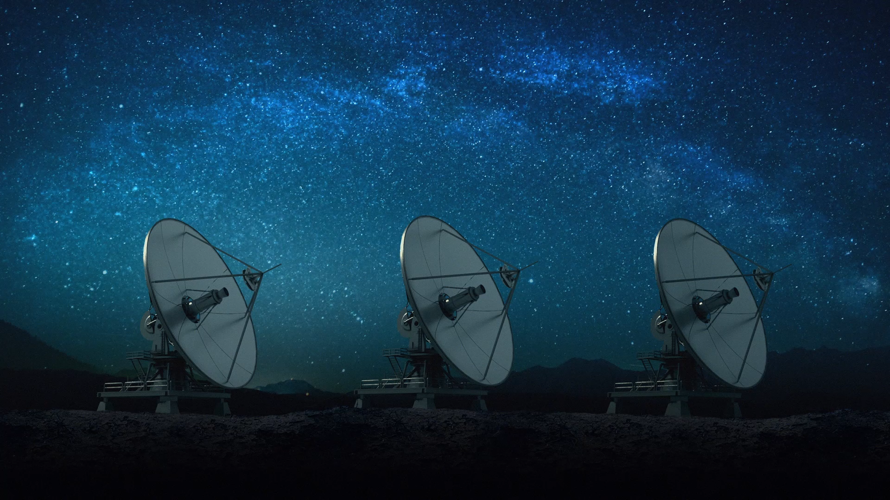

Orbitrons Guardians
Lewis Zhang
CCLab Project A

Slide 2

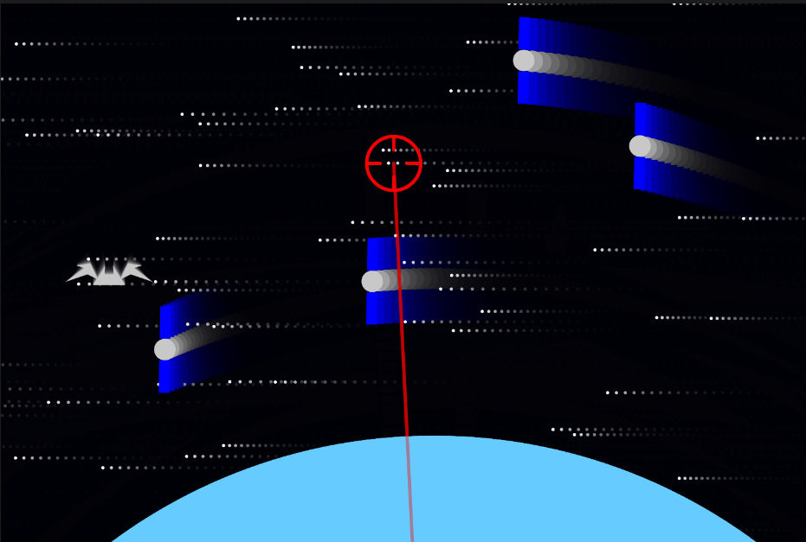
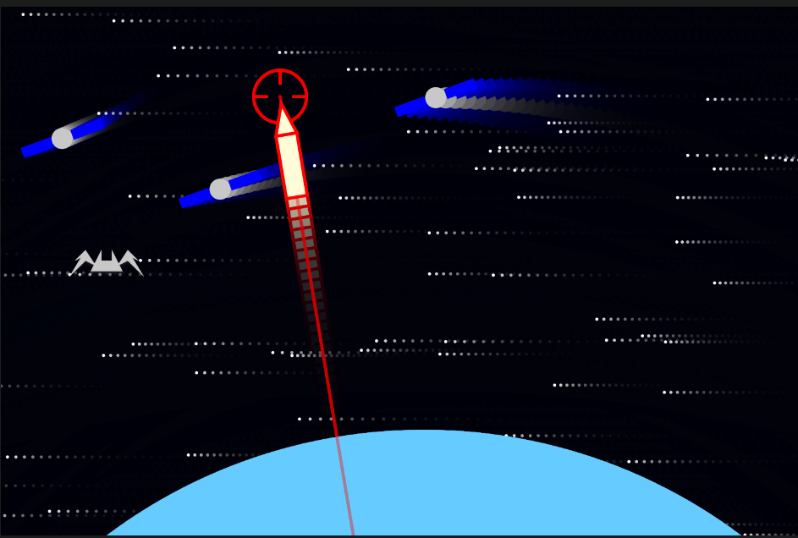
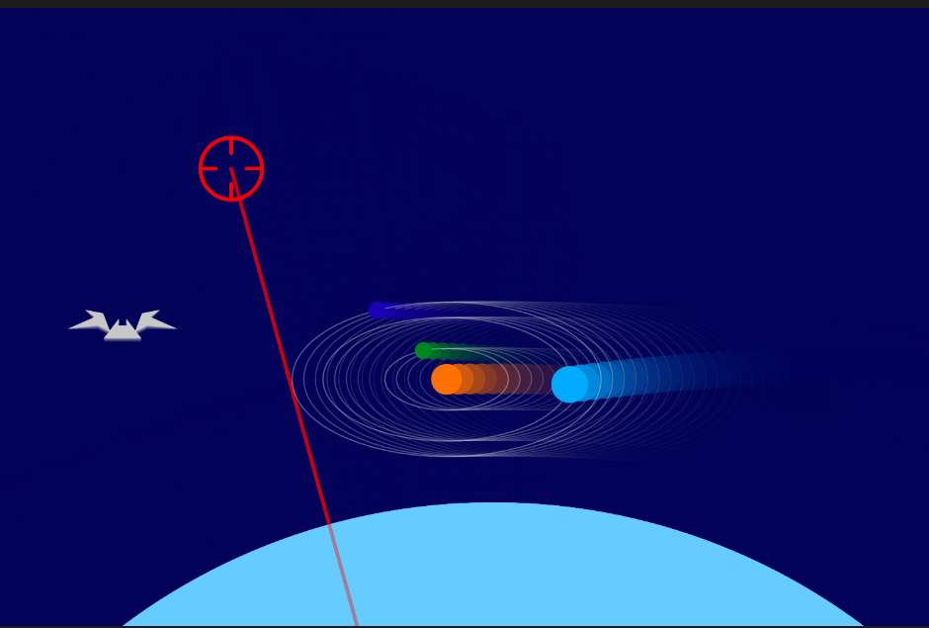
In the not-so-distant future, humanity's space debris threatens the existence of the newly discovered, solar-fed Orbitrons, who have been living in Earth's orbit for a long time.
You must strategically launch missiles to clear the debris and save these fragile beings from extinction. Precision and care are crucial—if the debris or the missiles you launch hit the beings, they will perish.
Orbitrons
Guardians

Slide 3
References
https://lawtro.itch.io/solar-view When creating the solar system simulation, it uses two layers of stars. When you move, it give you a Pseudo-3D feeling. I use this idea and create the backgrounds with shooting stars of different speed.
https://happycoding.io/tutorials/p5js/creating-classes/fireworks A demonstration that shows how to write a firework. I can use it in the explosion when missile hits the debris.

